Slide 1


Cloud Native Workshop What is Cloud Native?
IBM Hybrid Cloud Ecosystem
Ecosystem Labs

Slide 2

CNCF Cloud Native Definition
Cloud-native technologies empower organizations to build and run scalable applications in modern, dynamic environments such as public, private, and hybrid clouds. Containers, service meshes, microservices, immutable infrastructure, and declarative APIs exemplify this approach.
These techniques enable loosely coupled systems that are resilient, manageable, and observable. Combined with robust automation, they allow engineers to make high-impact changes frequently and predictably with minimal toil.

Slide 3
What is Cloud-Native?
Cloud-native is about how we build and run applications to take full advantage of cloud computing
Discrete and reusable components known as microservices.
Microservices act as building blocks and are often packaged in containers.
Microservices work together as a whole to comprise an application.
Each microservice can be independently scaled, continuously improved, and quickly iterated through automation and orchestration processes.
The flexibility of each microservice adds to the agility and continuous improvement of cloud-native applications.

Slide 4
Evolution of application architectures
Late 90’s | Enterprise Application (EAI) Services and Models Addressed integration and transactional challenges primarily by using message oriented middleware. Mostly proprietary systems needing a proliferation of custom interfaces.
Mid 00’s | Service Oriented Architectures Based on open protocols like SOAP and WSDL making integration and adoption easier. Usually deployed on an Enterprise ESB which is hard to manage and scale.
Early 10’s | API Platforms and API Management REST and JSON become the defacto standard for consuming backend data. Mobile apps become major consumers of backend data. New Open protocols like OAuth become available further simplifying API development .
2015 and beyond | Cloud Native and Microservice Architecture Applications are composed of small, independently deployable processes communicating with each other using language-agnostic APIs and protocols.
Notes:
When we talk about app modernization we’re really talking about moving towards a container based microservices architecture running in the cloud. In this intro we’ll look at what that microservices architecture looks like and some general best practices for operating successfully in this new environment. But before we do that lets talk a few moments to reflect on how we got here. Several significant milestones in the evolution of app architectures made where we are today possible and many of their contributions are still being used today.

Slide 5
Advantages of Cloud Native
Ready for market faster
Highly scalable
Resilient
Since development cycles are shortened, a microservices architecture supports more agile deployment and updates
As demand for certain services grows, you can deploy across multiple servers, and infrastructures, to meet your needs.
These independent services, when constructed properly, do not impact one another. This means that if one piece fails, the whole app doesn’t go down, unlike the monolithic model.
Easy to deploy
Accessible
More open
Because your microservice-based apps are more modular and smaller than traditional, monolithic apps the worries that came with those deployments are negated. This requires more coordination, which a service mesh layer can help with, but the payoffs can be huge
Because the larger app is broken down into smaller pieces, developers can more easily understand, update, and enhance those pieces, resulting in faster development cycles, especially when combined with agile development methodologies.
Due to the use of polyglot APIs, developers have the freedom to choose the best language and technology for the necessary function.

Slide 6
Disadvantages of Cloud Native
More elements to manage
New tools and processes needed
Culture change
Although microservices enable an iterative approach to application improvement, they also create the necessity of managing more elements. Rather than one large application, it becomes necessary to manage far more small, discrete services.
Cloud native apps demand additional toolsets to manage the DevOps pipeline, replace traditional monitoring structures, and control microservices architecture.
Cloud native applications allow for rapid development and deployment, but they also demand a business culture that can cope with the pace of that innovation.

Slide 7
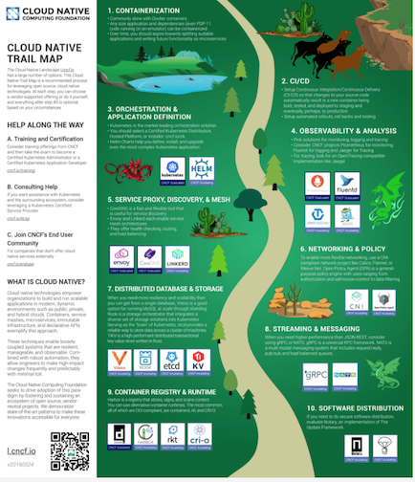
Cloud-Native Roadmap
Containerization
CI/CD
Orchestration and Application Definition
Observability and Analysis
Service Proxy, Discovery, and Mesh
Networking and Policy
Distributed Database and Storage
Streaming and Messaging
Container Registry and Runtime
Software Distribution

Slide 8
Characteristics of Cloud-Native Applications
Disposable infrastructure
Isolation
Scalability
Disposable architecture
Value-added cloud services
Polyglot cloud
Self-sufficient, full-stack teams
Cultural Change

Slide 9
Why microservices and cloud native?
Efficient teams
End to end team ownership of relatively small codebases
Teams can innovate faster and fix bugs more quickly
Simplified deployment
Each service is individually changed, tested, and deployed without affecting other services
Time to market is accelerated.
Right tools for the job
Teams can use best of breed technologies, libraries, languages for the job at hand
Leads to faster innovation
Improved application quality
Scalability
Services can be tested more thoroughly in isolation
Better code coverage
Services can be scaled independently at different rates as needed
Leads to better overall performance at lower cost

Slide 10
Cultural change considerations
Smaller teams with broader scope
Mini end to end development orgs in each team vs large silos across the entire development team
Top down support with bottom up execution
Change can’t happen effectively w/o executive sponsorship
Change needs to be executed at the smallest organizational unit to take hold
Teams own all metrics related to operations and development
Have to minimize downtime + number of bugs while also maximizing the rate at which needed features are added and minimizing the time to market of those new features
Trust
Teams need to build trust with other teams that they collaborate with rather than relying on one size fits all checklists and rules
Reward based on results not compliance
Cultures only change when people are measured and rewarded for outcomes consistent with the changes
Smaller more autonomous teams work better with less central micromanagement and more focus on broad measurable goals

